Slide 1




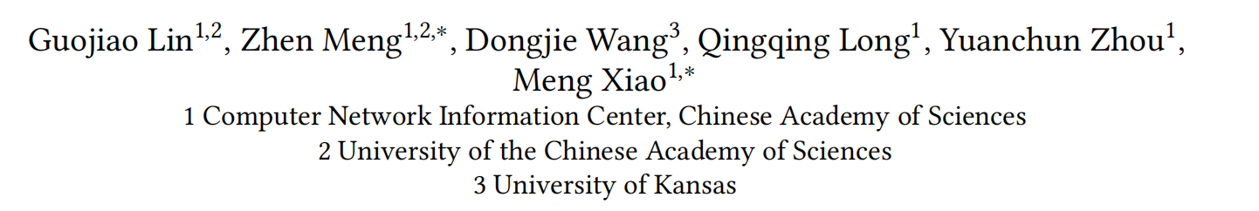





ATAI
Advanced Techniqueof Artificial Intelligence
ATAI
ChongqingUniversity _{AdvancedTechniqueof}
of Technology Artificial Intelligence
Chongqing University of
Technology
Chongqing University ^{ATAI}
_{of Technology} Advanced Techniqueof
Artificial Intelligence
Chongqing University of Technology
Chongqing University of Technology
GUME: Graphs and User Modalities Enhancement for Long-Tail
Multimodal Recommendation
Code: https://github.com/NanGongNingYi/GUME/
2024.9.29 •ChongQing
—— CIKM 2024
Reported by Ling Tan
1

Slide 2

ATAI
AdvancedTechniqueof
Artificial Intelligence
ATAI
ChongqingUniversity _{AdvancedTechniqueof}
of Technology Artificial Intelligence
ChongqingUniversity of Technology
Motivation
（1） First, many long-tail items in recommendation systems have limited interaction data,
making it difficult to learn comprehensive and informative representations.
（2）Secondly, users’ modality preferences are crucial to their behavior.However, previous research has primarily focused on learning item modality representations, while user modality representations have remained relatively simplistic

Slide 3

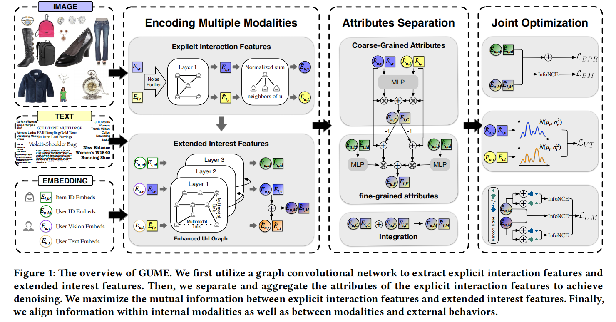
ChongqingUniversity of Technology
ATAI
AdvancedTechniqueof
Artificial Intelligence
ATAI
ChongqingUniversity _{AdvancedTechniqueof}
of Technology Artificial Intelligence
Overview

Slide 4

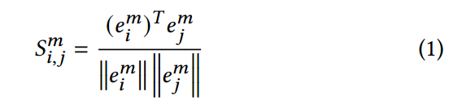



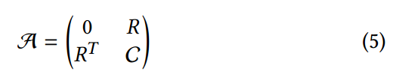
ChongqingUniversity of Technology
ATAI
AdvancedTechniqueof
Artificial Intelligence
ATAI
ChongqingUniversity _{AdvancedTechniqueof}
of Technology Artificial Intelligence
Method

Slide 5





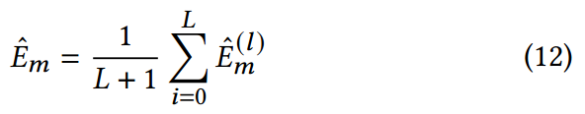
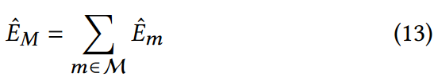
ChongqingUniversity of Technology
ATAI
AdvancedTechniqueof
Artificial Intelligence
ATAI
ChongqingUniversity _{AdvancedTechniqueof}
of Technology Artificial Intelligence
Method

Slide 6
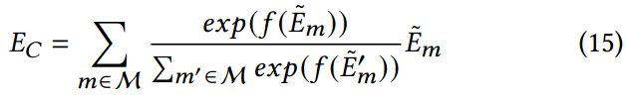



ChongqingUniversity of Technology
ATAI
AdvancedTechniqueof
Artificial Intelligence
ATAI
ChongqingUniversity _{AdvancedTechniqueof}
of Technology Artificial Intelligence
Method

Slide 7


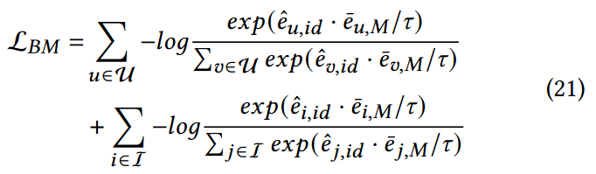

ChongqingUniversity of Technology
ATAI
AdvancedTechniqueof
Artificial Intelligence
ATAI
ChongqingUniversity _{AdvancedTechniqueof}
of Technology Artificial Intelligence
Method

Slide 8

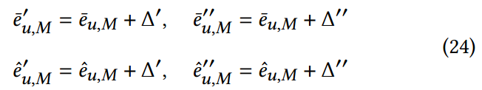
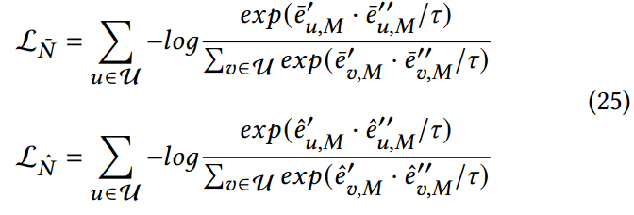

ChongqingUniversity of Technology
ATAI
AdvancedTechniqueof
Artificial Intelligence
ATAI
ChongqingUniversity _{AdvancedTechniqueof}
of Technology Artificial Intelligence
Method

Slide 9



ChongqingUniversity of Technology
ATAI
AdvancedTechniqueof
Artificial Intelligence
ATAI
ChongqingUniversity _{AdvancedTechniqueof}
of Technology Artificial Intelligence
Method

Slide 10

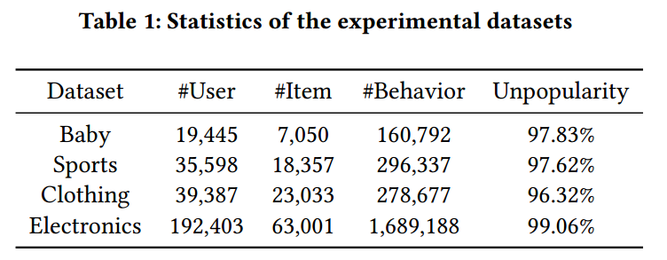
ATAI
AdvancedTechniqueof
Artificial Intelligence
ATAI
ChongqingUniversity _{AdvancedTechniqueof}
of Technology Artificial Intelligence
ChongqingUniversity of Technology
Experiments

Slide 11
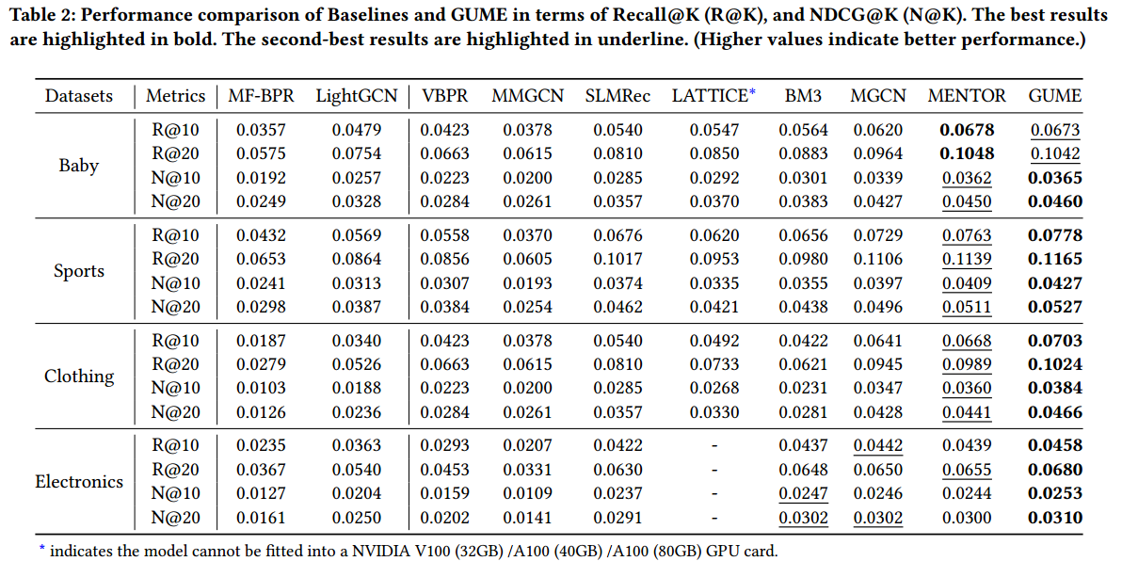
ATAI
AdvancedTechniqueof
Artificial Intelligence
ATAI
ChongqingUniversity _{AdvancedTechniqueof}
of Technology Artificial Intelligence
ChongqingUniversity of Technology
Experiments

Slide 12
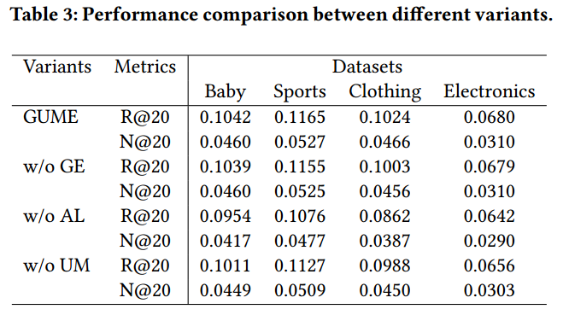
ATAI
AdvancedTechniqueof
Artificial Intelligence
ATAI
ChongqingUniversity _{AdvancedTechniqueof}
of Technology Artificial Intelligence
ChongqingUniversity of Technology
Experiments

Slide 13
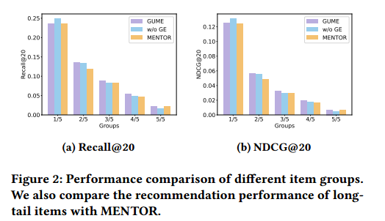
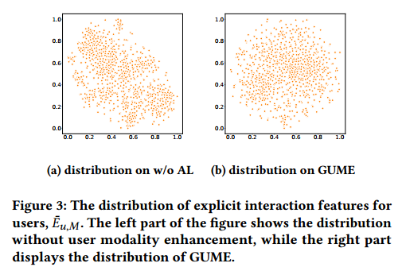
ATAI
AdvancedTechniqueof
Artificial Intelligence
ATAI
ChongqingUniversity _{AdvancedTechniqueof}
of Technology Artificial Intelligence
ChongqingUniversity of Technology
Experiments

Slide 14
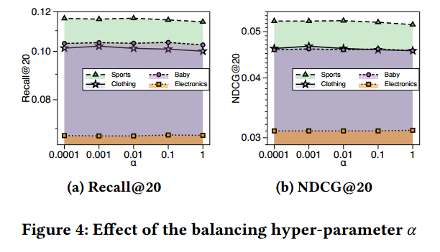
ATAI
AdvancedTechniqueof
Artificial Intelligence
ATAI
ChongqingUniversity _{AdvancedTechniqueof}
of Technology Artificial Intelligence
ChongqingUniversity of Technology
Experiments

Slide 15
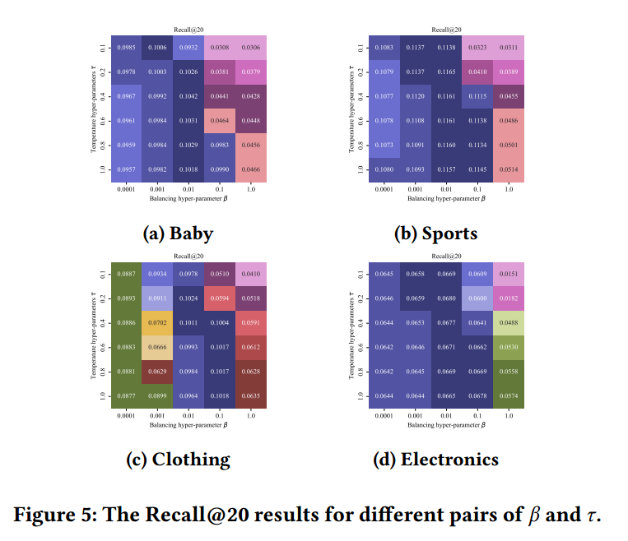
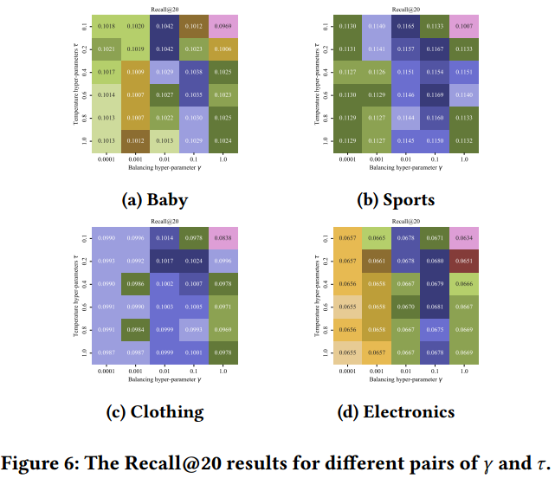
ATAI
AdvancedTechniqueof
Artificial Intelligence
ATAI
ChongqingUniversity _{AdvancedTechniqueof}
of Technology Artificial Intelligence
ChongqingUniversity of Technology
Experiments

Slide 16


ChongqingUniversity of Technology
ATAI
AdvancedTechniqueof
Artificial Intelligence
ATAI
ChongqingUniversity _{AdvancedTechniqueof}
of Technology Artificial Intelligence
Thanks!

